Slide 1
Progress Report on the Module: Pond Area Meter

Slide 2
Theoretical Model
Module 1-
Image Acquisition
Image acquisition of pond from a raspberry module.
Extraction of RAW image from the acquired image.
Separation of RGB and NIR components from the RAW image.
Module 2-
Image Processing
Feature detection of the image.
Area detection of the pond from image using detected feature
Image alignment(skewed image).
Area calculation of the image.

Slide 3
FLOWCHART-Module 1
Acquire the image of the pond using Raspberry Pi NOIR Camera
RGB+NIR is the output
RGB image is used for Feature detection whereas NIR is used for pond area measurement
RGB and NIR images are separated
Extract the RAW image from the input image

Slide 4
CHALLENGES
Formats such as JPEG and PNG does not contain the information of Infra-Red spectrum.
Extracting pure RAW image from the output of Raspberry pi.
Extracting exact Infra Red image.

Slide 5
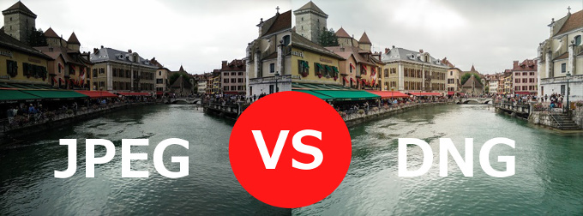
FINAL PROTOTYPE

Slide 6
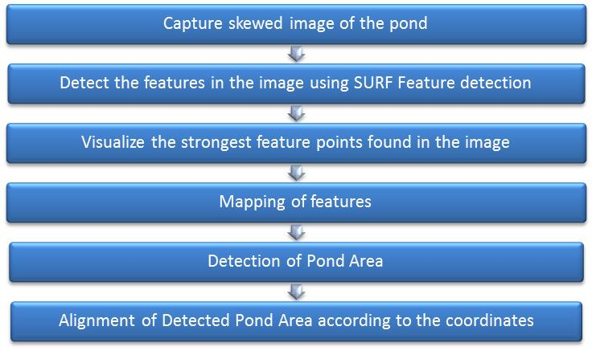
Flowchart-Module 2

Slide 7
Challenges
Improper Readings of GPS Coordinates.
Detection of desired Features (Flags).
Improper matching of detected features
Detection of precise pond area.
Improper alignment of skewed image

Slide 8
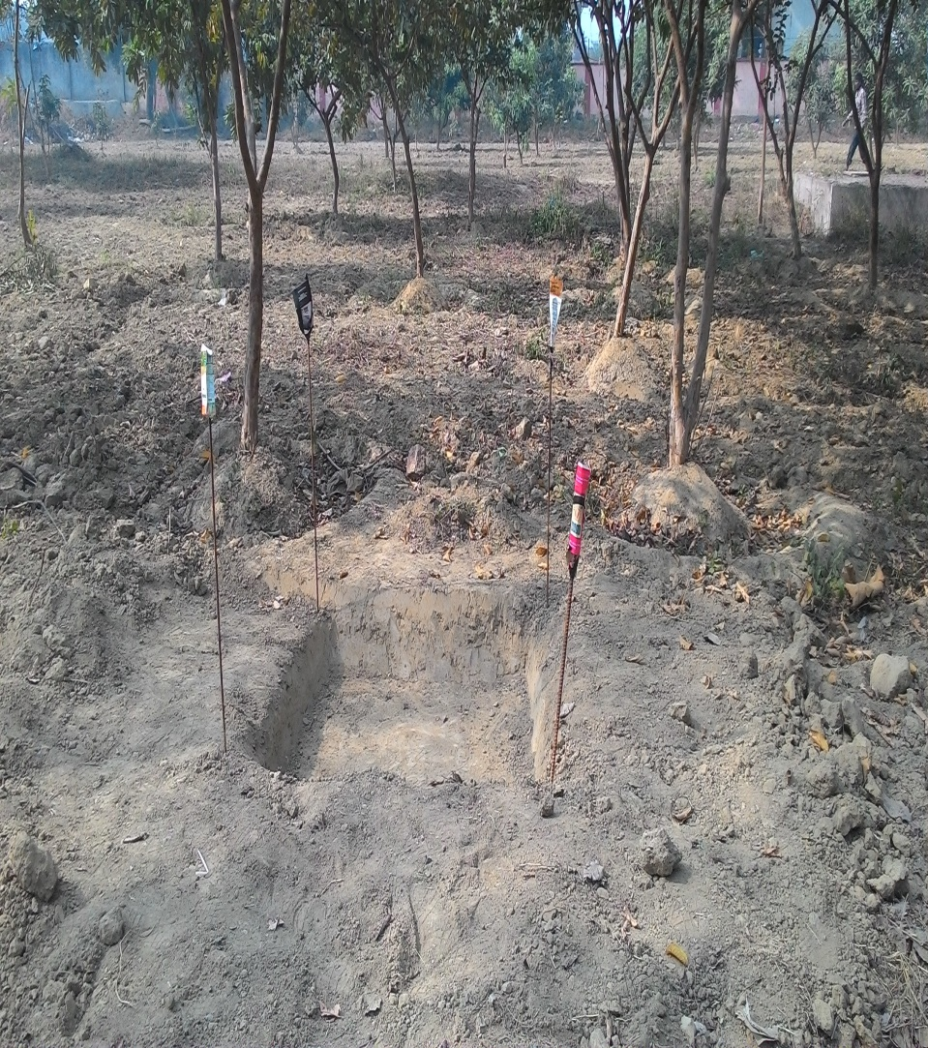
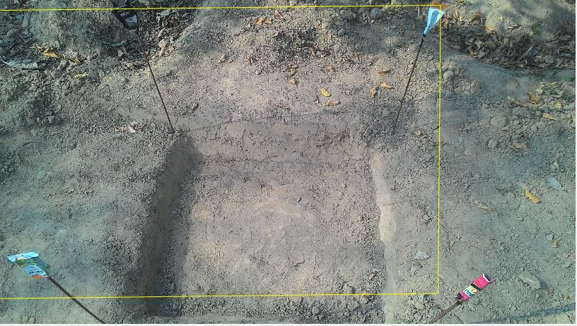
Final Prototype

Slide 9
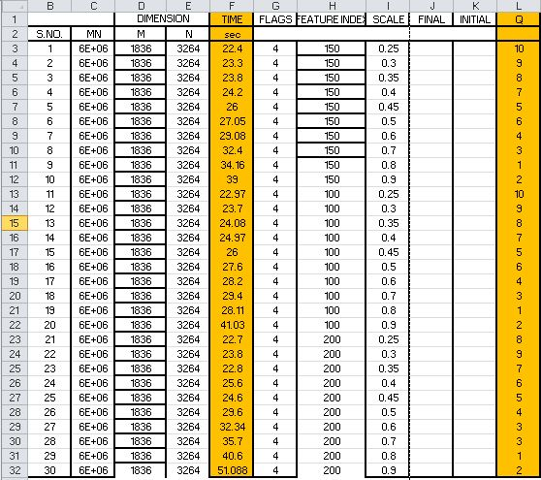
Data- Generation

Slide 10
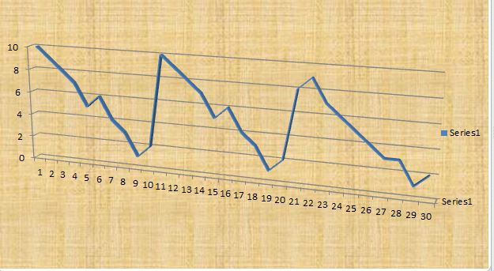
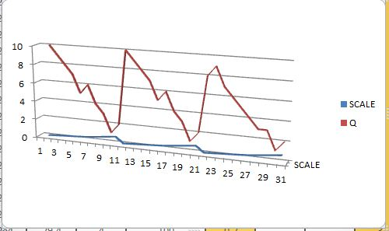
Data Curves

Slide 11
Changes Suggested
More Precise detection of features.
Exact alignment of skewed image along coordinates generated from GPS.
Exact pond area detection.
Highly Precise Calibration of pond area.
Precise results even in low resolution image.

Slide 12
CONCLUSION
The skewed image was corrected by detecting features in the image.
RGB+NIR extraction and Pond area measurement are currently in progress.

Slide 13
REFERENCES
Digital image processing by Gonzalez.
https://www.mathworks.com
https://www.cse.usf.edu
http://aggregate.org/dit/rgbnir/
http://www.cybercom.net/~dcoffin/dcraw/
https://www.raspberrypi.org/

